Slide 1


M.Tech Program
Advanced Industry Integrated Programs
Jointly offered by University and LTI MindTree
Graph RAG based Financial Insights
DEV S SHAH
VIT CHENNAI
Knowledge partner | Implementation Partner

Slide 2
Graph RAG based Financial Insights
Introduction
Problem
Annual reports = Tables + Text + Strategy + Risk
Financial information is distributed across pages
Traditional search finds text, not relationships
LLMs may generate unsupported answers
Proposed Idea
Financial Fact Extraction
Entity & Relationship Extraction
Neo4j Knowledge Graph
Multi-Hop Graph Retrieval
Ollama + Local Model
Source/Page Grounding

Slide 3
Graph RAG based Financial Insights
Objective
Extract financial facts
Identify business entities
Discover semantic relationships
Build a Neo4j financial knowledge graph
Perform multi-hop reasoning
Retrieve source/page evidence
Generate answers using local model
Minimize hallucination

Slide 4
Graph RAG based Financial Insights
Scope
Input
LTM Annual Reports
Financial Statements
Management Discussion
Strategy & Risk
Business Information
Processing
PDF Parsing
Normalization
Fact, Entity Extraction
Relationship Extraction
Knowledge
Financial Metrics
Financial Values
Reporting Periods
Source Pages
Output
Financial Answers
Multi-Hop Reasoning
Graph Evidence
Page-Level Provenance

Slide 5
Graph RAG based Financial Insights
Literature Review
Paper | Key Contribution
Lewis et al. (2020) — RAG | External knowledge retrieval + LLM generation
Reimers & Gurevych (2019) — SBERT | Semantic embeddings for similarity search
Chen et al. (2021) — FinQA | Numerical reasoning over financial reports
Zhu et al. (2021) — TAT-QA | Question answering over financial text + tables
Edge et al. (2024) — GraphRAG | Knowledge graphs + multi-hop/global reasoning

Slide 6
Graph RAG based Financial Insights
Summary of Literature
Key Findings
RAG → External knowledge + LLM generation
SBERT → Semantic similarity-based retrieval
FinQA → Financial numerical reasoning
TAT-QA → Text + table reasoning
GraphRAG → Multi-hop relationship reasoning
Research Gap
Limited integration of financial facts, graph relationships, document context, and source provenance.

Slide 7
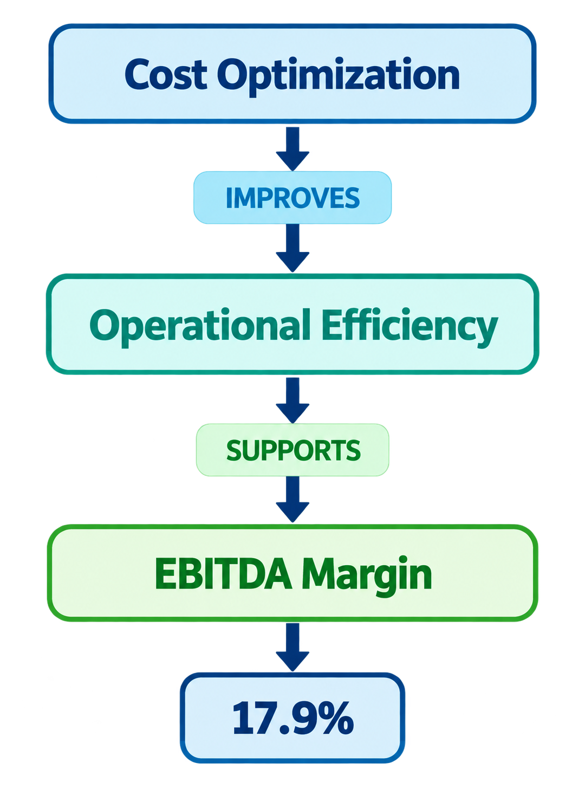
Graph RAG based Financial Insights
Additional Information
How does cost optimization relate to EBITDA margin?
Key Advantages
Relationship-Aware Retrieval
Multi-Hop Reasoning
Financial Fact Retrieval
Source/Page Traceability
Local LLM Inference
Reduced Hallucination
Explainable Answers

Slide 8
Graph RAG based Financial Insights
Modules to cover…. Calibri body -36
Data Ingestion – PDF data extraction
Knowledge Graph – Entity relationship mapping
Vector Database – Semantic search storage
Hybrid Retrieval – Graph + vector retrieval
Answer Generation – LLM-powered insights
Multi-Year Analysis – Fiscal trend tracking
Evaluation Module – Accuracy assessment
User Interface – Interactive dashboard
Infrastructure – Deployment & orchestration

Slide 9
Graph RAG based Financial Insights
Financial Intelligence GraphRAG Engine
Core Logic: Decoupled LLM reasoning from financial math to eliminate hallucination.
Dual-DB Architecture: Integrated Neo4j (structured facts) + Postgres/pgvector (narrative context).
Structured Parsing: Deployed IBM Docling to preserve table integrity from complex PDF filings.
Intelligent Routing: Developed hybrid_router.py to map user intent to optimal retrieval strategy.
LangGraph Orchestration: Implemented stateful workflow to fuse graph nodes + vector chunks into verifiable answers.

